Slide 1

Group: Nykaarious
Aksharaa Sundarrajan | Prerna Luthra | Siddhartha Khanooja | Sreeja Nair

Slide 2
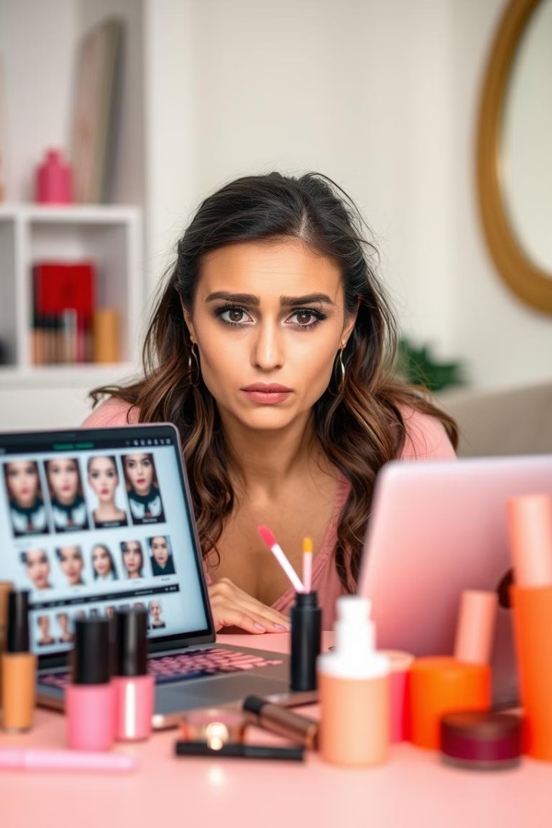
The Makeup Shopper's Dilemma
1
Limited Confidence
Ordering new makeup shades online can feel uncertain
2
Go-To Products
Shoppers have a few trusted lipstick and foundation shades
3
Experimentation Challenges
Trying new brands or shades feels like a gamble
4
Suitability Concerns
Difficulty in determining if a new product will actually suit the buyer

Slide 3
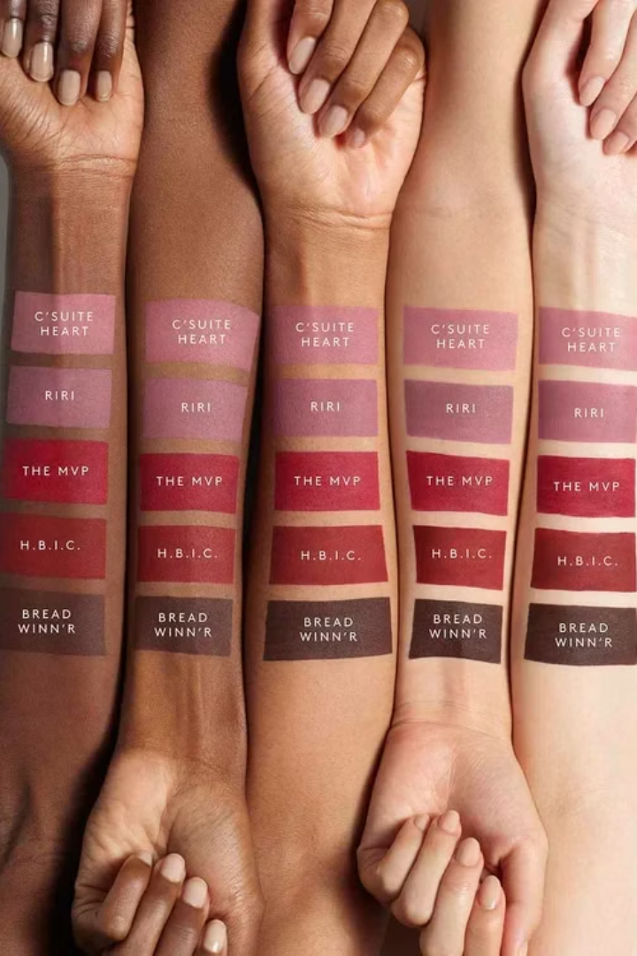
The Problem with Online Makeup Shopping
Online Gamble
Misleading Visuals
Inconvenient Offline Trials
Time-Consuming Research
Outcome?
A delayed buying cycle and a missed opportunity for brands to convert interest into purchase.

Slide 4
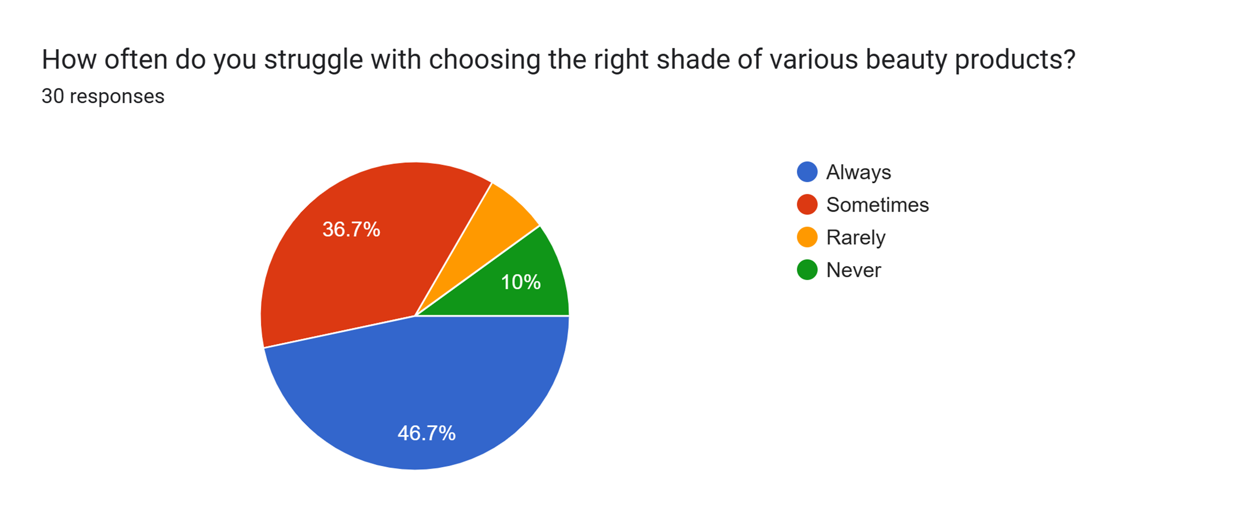
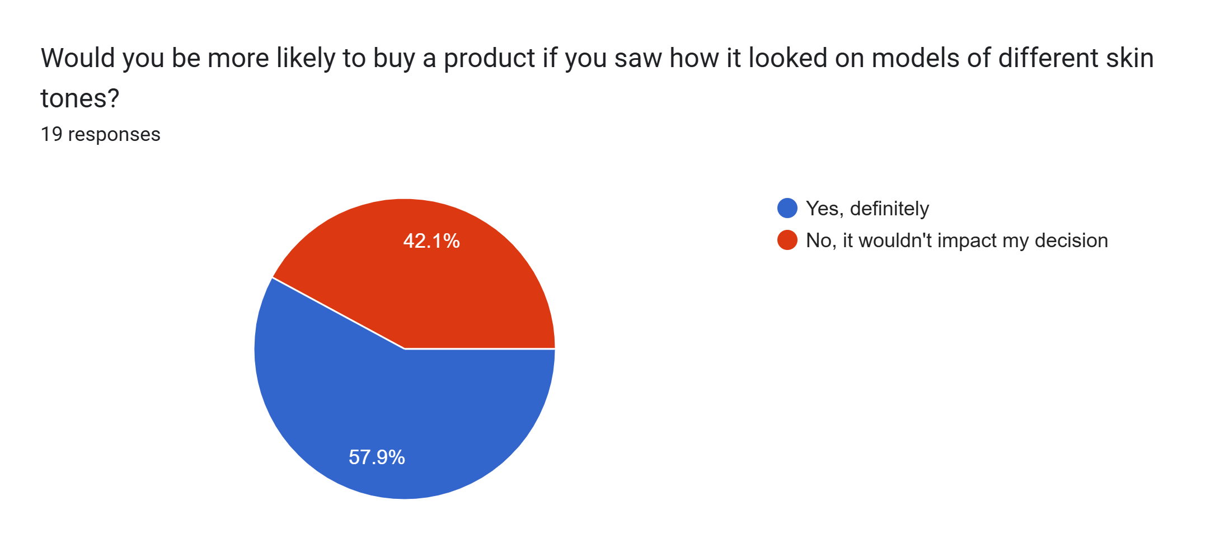
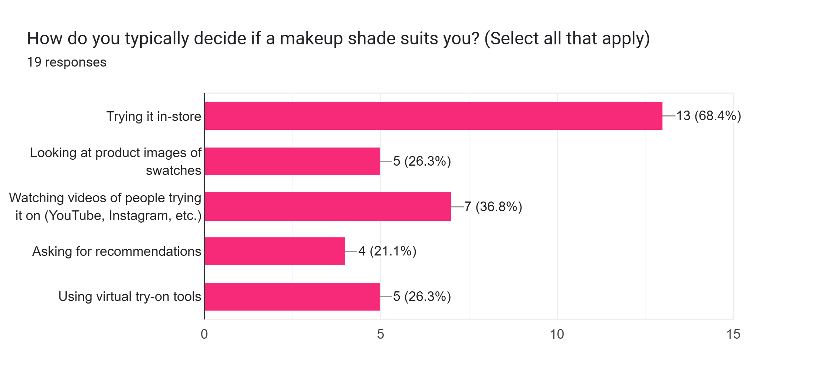
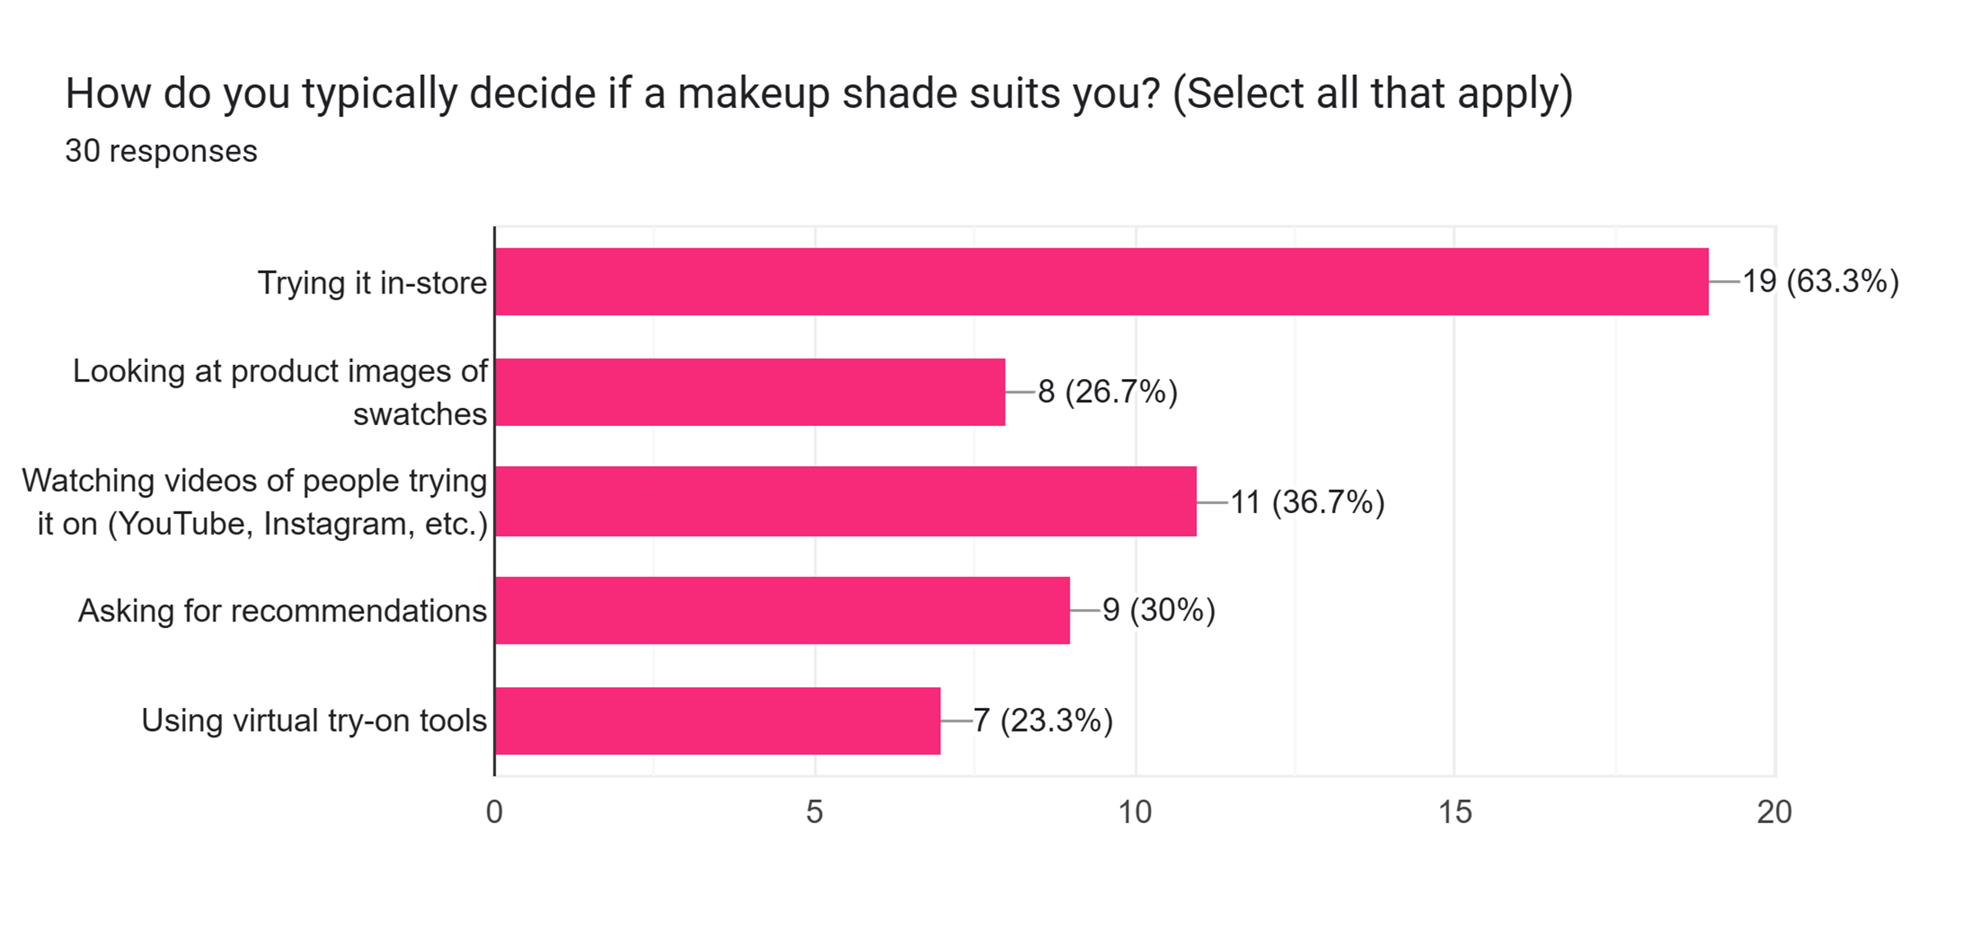
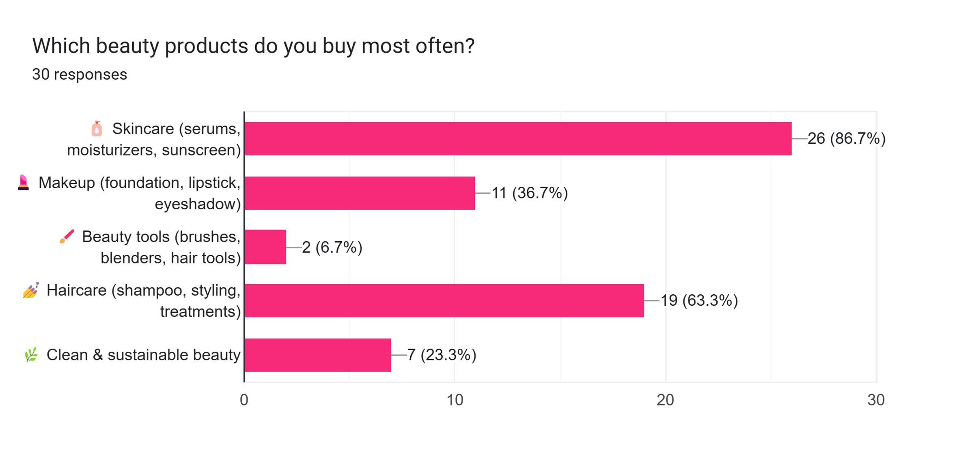
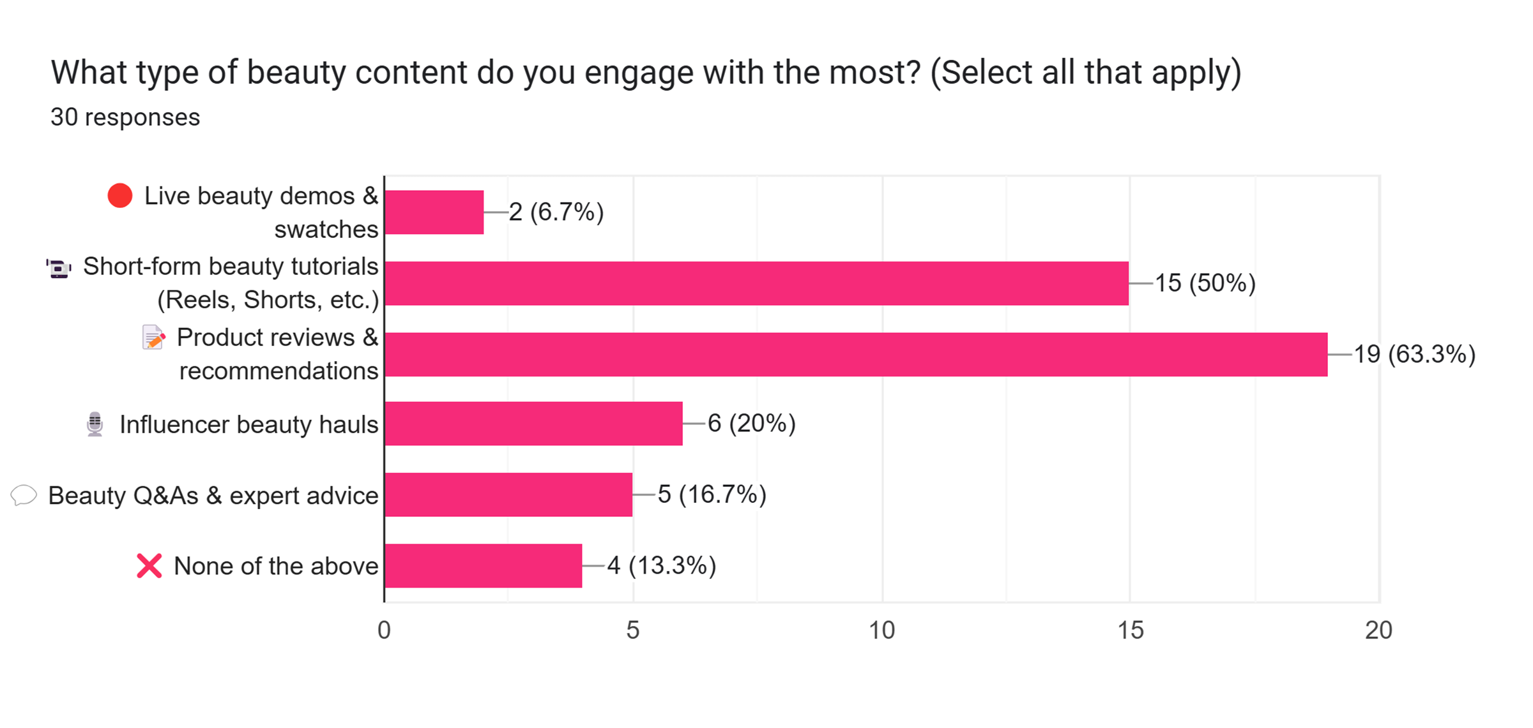

Slide 5
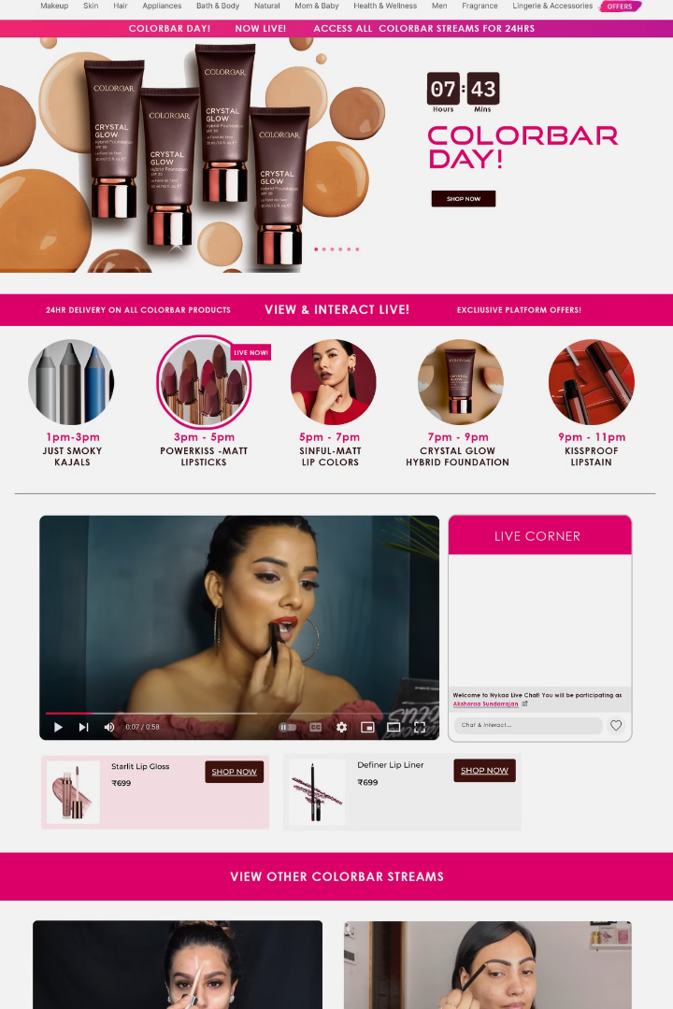
Solution?
BRAND WEEK
For the Shopper:
1
A Brand Week that brings top beauty brands live on one interactive page
2
Pre-scheduled slots – clear communication, real-time engagement and first-hand answers
3
Clubbed offers, and one-day delivery incentives

Slide 6
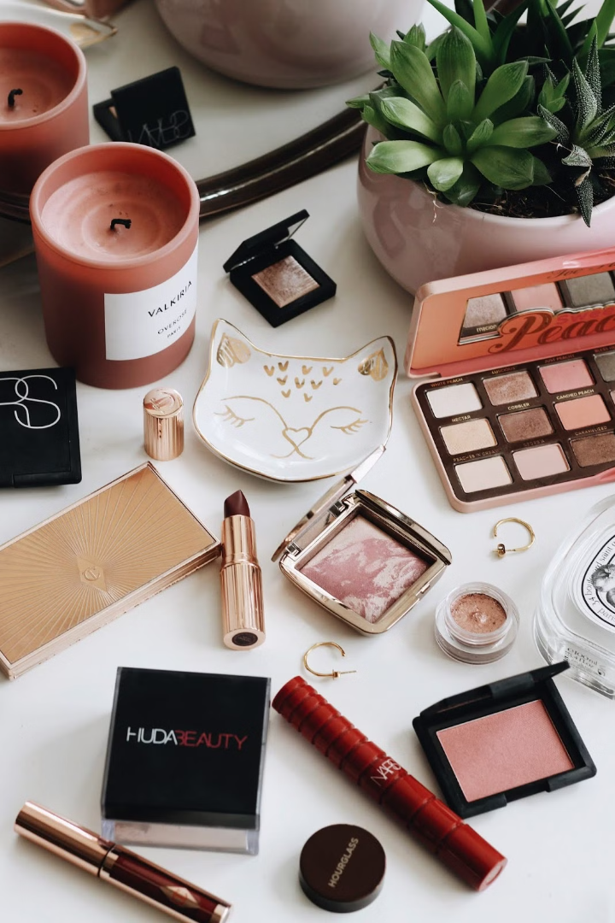



Solution?
BRAND WEEK
For the Brand:
Premium Visibility
Direct Engagement
Brand Trust
Stronger brand trust (immersive shopping experience)
Premium visibility (real estate & marketing)
Direct consumer engagement

Slide 7
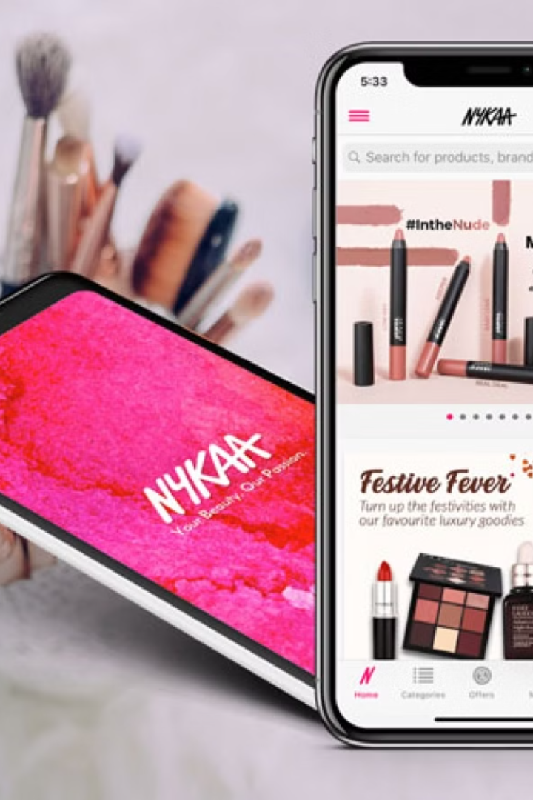



Solution?
BRAND WEEK
For Nykaa:
Monetization
Slot Auctioning and monetization
User Retention
Reduced platform swap and higher retention
Platform Growth
Platform promotion from featured brand thereby improving platform reach and trust

Slide 8
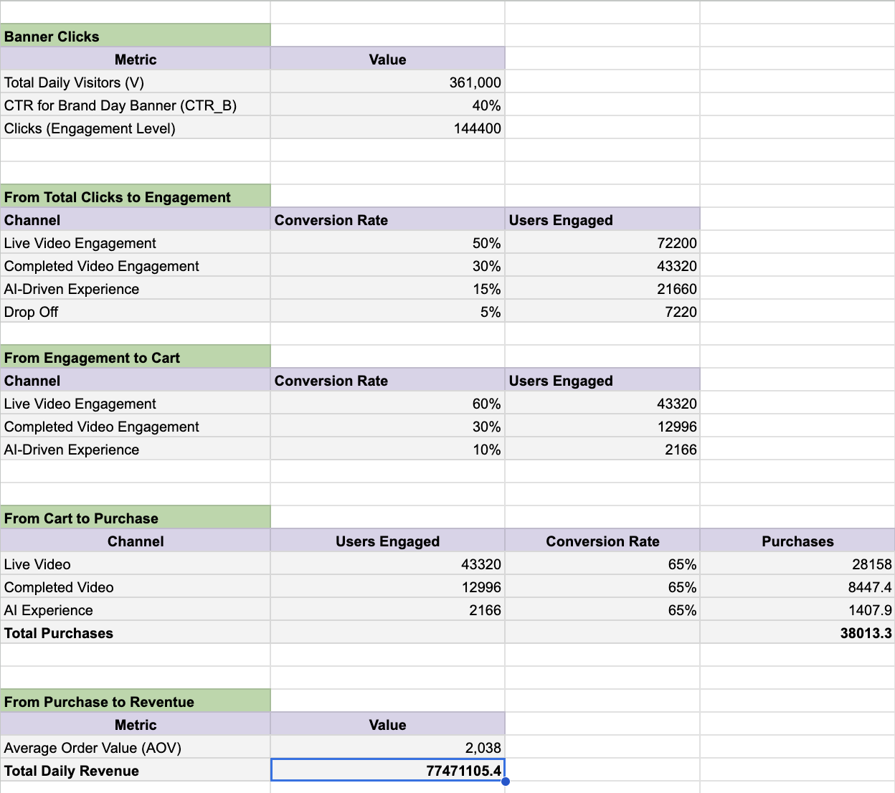
Revenue Estimation Model
Notes:
https://docs.google.com/spreadsheets/d/1_a6JuFlx0uL7b33aTTacLo3r5qqltWzKqndEpw7yRuM/edit?usp=sharing

Slide 9
What does data say about Live Commerce?
10X
73%
47%
Higher Conversion than traditional ecommerce
Consumers are more likely to make a purchase after watching a live event
viewers make impulse purchases during live sessions
81%
46%
64%
Chinese consumers had used livestream commerce by 2023 to buy products
US consumers have made a purchase through livestream events
Indian social media users make purchases directly , indicating a strong shift towards social commerce.

Slide 10
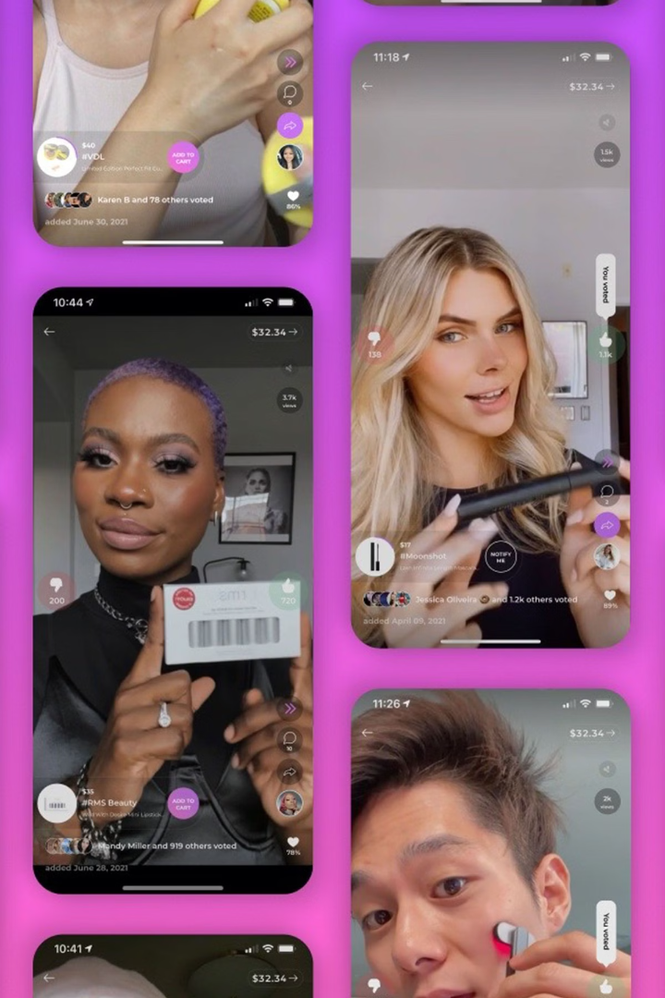
Global Success & Emerging Trends
1
Taobao Live (China)
2
Kiehl’s (Instagram Live)
$7.5B in sales in 30 minutes during Singles’ Day presales (2020).
8x ROAS during Ramadan; 50% of new customers in H1 2021 came from this campaign.
3
JUNGLUCK (Germany)
4
Hobbii (Live Shopping)
70% increase in customer interactions, 30% rise in add-to-carts via live streaming.
5x higher conversion vs. paid ads; every 6th comment led to a purchase.
5
Competitor Activity
6
Alternatives
Amazon, Myntra, and Flipkart are experimenting with live commerce, but engagement remains low due to limited integration & interactive features.
AI & virtual try-ons address similar concerns but need advancements for trust & mass adoption.

Slide 11
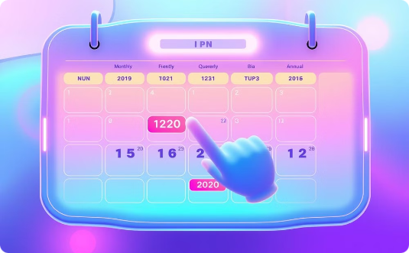

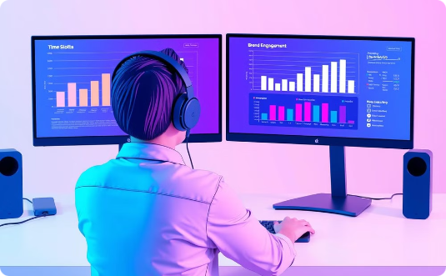
BRAND WEEK: A Scalable Solution
Scalability
NykaaAI Improvements
Data-Driven Optimization
BRAND WEEK can be activated monthly, quarterly, or bi-annually, allowing flexibility for brands and shoppers.
Enhance NykaaAI’s interactive capabilities to create a more engaging and personalized shopping experience.
Leverage data to optimize time slots and scheduling, and share engagement analytics to refine content strategies.

Slide 12
ROADMAP FOR IMPLEMENTATION
Product Journey: Research to Launch and Beyond
RESEARCH & STRATEGY
Analyze live commerce data, define success metrics, and survey users & brands.
Upgrade live shopping features, optimize checkout, and build NykaAI.
BRAND & INFLUENCER ONBOARDING
Partner with top brands, recruit beauty experts, and finalize content strategy.
PRE-LAUNCH & TESTING
POST-LAUNCH OPTIMIZATION
Run pilot sessions, test engagement tools, and gather initial feedback.
Analyze performance, refine strategies, and scale based on insights.
Execute the first Brand Carnival with optimized scheduling and promotions
TECH & PLATFORM ENHANCEMENTS
Full-Scale Launch

Slide 13
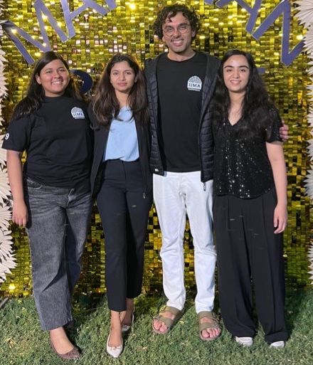
SIGNING OFF
TEAM NYKAARIOUS

